Slide 1
SOFE 3950U: Operating Systems Tutorial #4: Jeopardy Tutorial CRN: 74027 Tutorial Group 2 Rivka Sagi 100780926 Rhea Mathias 100825543 Julian Olano Medina 100855732 Omokorede Olobayo 100875182

Slide 2
introduction
Overview of the project: Creating a command-line Jeopardy game in C.
The game supports four players, tracks scores, and determines a winner.

Slide 3
How the Game Works
Players enter their names.
Categories and dollar values are displayed.
Players select a question; program ensures it's available.
The question is displayed; players must answer in the form of "What is" or "Who is".
Correct answers earn points; incorrect answers don’t.
The game continues until all questions are answered.
The player with the highest score wins.

Slide 4
Players.c and players.h
Deals with the player initialization and keeps track of both the player roster and the points associated with each player

Slide 5
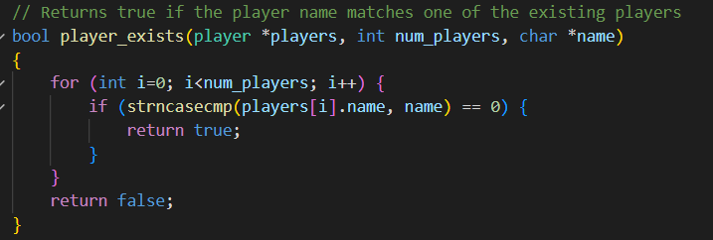
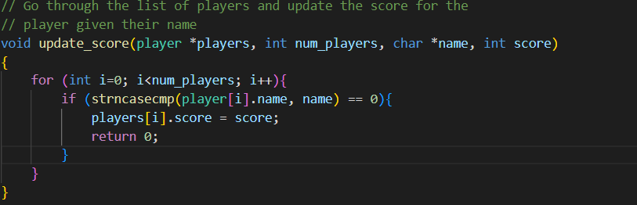
player_exists()
update_score()
The player_exists() function checks if a player’s name matches a list of existing players by looping through the names and by using strncasecmp to compare the player’s name (case insensitive) to the list, it returns true if the name exists or returns false if it does not.
The update_score() function updates a player's score by looping through the list of players to find a player’s name (using strncasecmp), and once the name is found, it updates that player's score.

Slide 6
questions.c and questions.h
Deals with all the functionalities related with the questions such as creating the categories, points and the questions themselves. There are also functions that create the question grid with their values displayed along with showing which questions were already answered

Slide 7
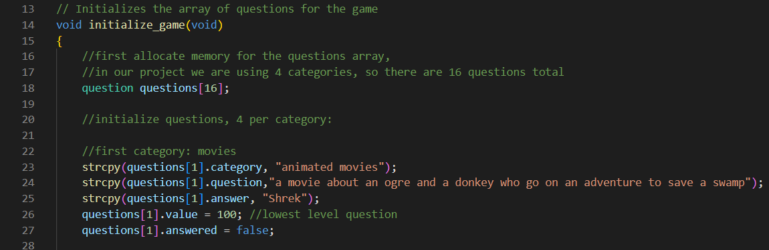
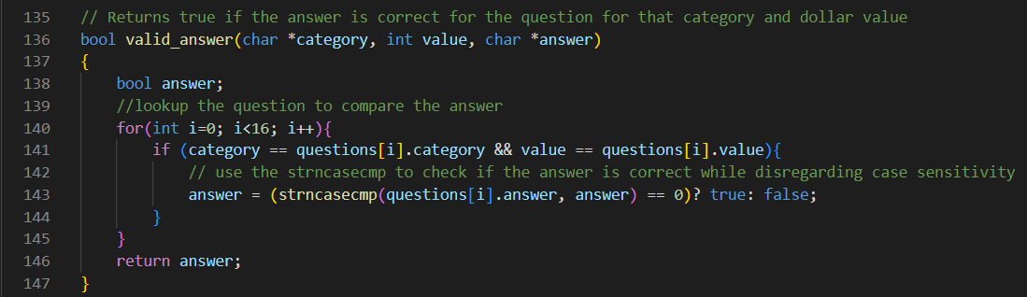
initialize_game()
valid_answer()
The initialize_game() code creates an array of question structs to hold the questions and then assigns the category, question, answer, value, and answered status to the structs initialized in the array.
The valid_answer() code finds the relevant question in the array by searching for the category and the question value. It then compares the provided answer with the correct answer, returning true if the answer is correct and false if not.

Slide 8
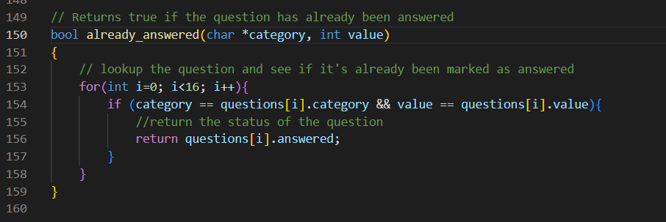
already_answered()
The already_answered() code finds the relevant question in the array by searching for the category and the question value. It then returns the answered status of the question, whether it has already been answered or not.

Slide 9
jeopardy.c and jeopardy.h
Uses the main() function to render inputs from users as well as tokenize the inputs and display the results of each round.

Slide 10
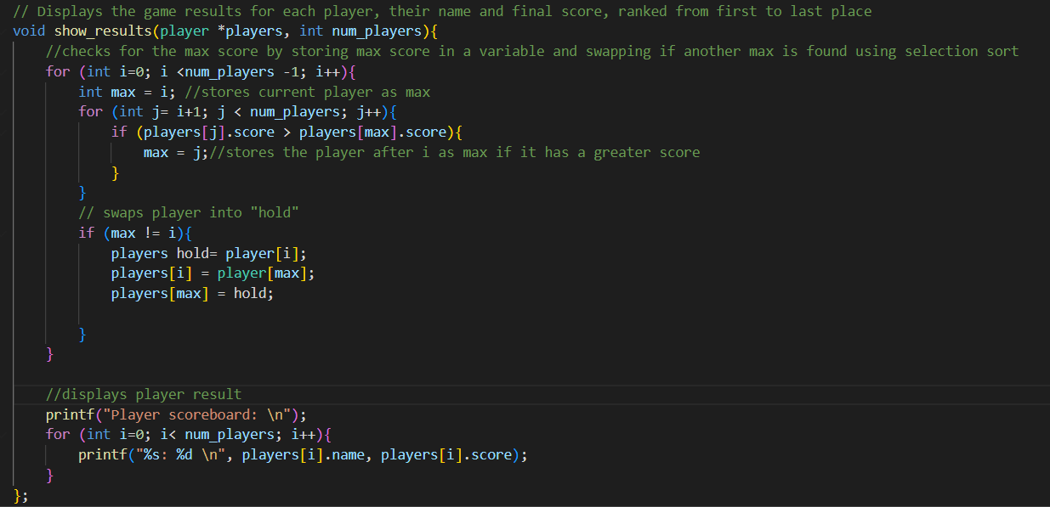
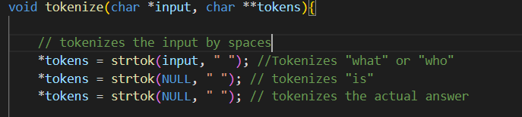
tokenize()
show_results()
The tokenize() function is used to tokenize only the answer from the input by disregarding the “what is” or “who is” statement considering that the answer is only one word. To do so, strtok() is used to tokenize each word of the input by using a space as a delimiter.
The show_results() function is used to display the current player scoreboard by iterating through the player roster and comparing their score value by using the selection sort algorithm.

Slide 11
conclusion
We were able to successfully create a functional Jeopardy game in C. We structured the program with multiple source files so as to allow four players to compete, keep track of their scores, and then determine a winner based on the highest points earned.

Slide 12
Thank you
Rivka Sagi
Rhea Matthias
Julian Olano Medina
Omokorede Olobayo

